Slide 2
Lesson 3: Object Oriented Design (10hrs)
Writing contracts: Describing and Elaborating Use Cases
Collaboration Diagram and Sequence Diagram
Objects and Patterns (information expert, creator, low coupling, high cohesion, controller)
Determining Visibility
Class Diagram

Slide 3
Practice
Draw Sequence Diagram for a hotel reservation scenario.
The Reservation window sends a makeReservation() message to a HotelChain.
The HotelChain then sends a makeReservation() message to a Hotel.
If the Hotel has available rooms, then it makes a Reservation and a Confirmation.

Slide 4
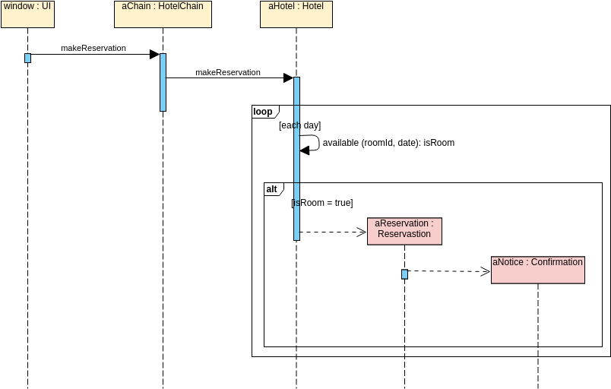
Practice

Slide 5
Practice
A member of a ship who would like to place an order online.
The item ordered will be sent to the member either sent by Courier or by ordinary mail depending on the membership status that is VIP membership or ordinary membership.
Optionally, the shop would send the member a confirmation notification if the member opted for the notification option in the order.
Draw Sequence Diagram

Slide 6
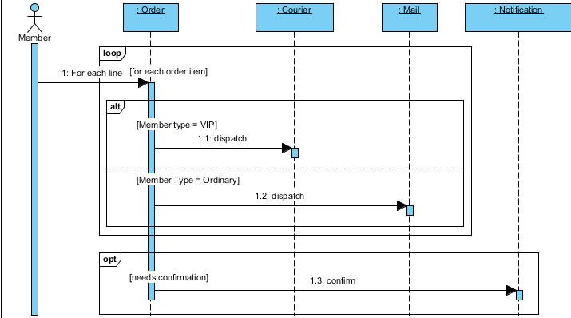
Practice

Slide 7
Practice
A final exam for a given course is prepared by the instructor of the course and submitted to the IT undergraduate office by July 20.
The undergraduate office sends all exams to the Faculty of Information Technology office where copies are made.
On the day of the exam, copies are given to the presiding officer who takes them to the room where the exam is given.
The students write the exam on an exam copy and return to the presiding officer at the end of the exam.
The written exam copies are given to the instructor for marking.
Draw sequence diagram for given scenario.

Slide 8
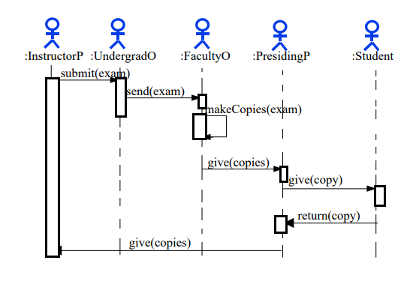
Practice

Slide 9
Practice
To give an exam an instructor first notifies the students of the exam date and the materials to be covered.
She then prepares the exam paper (with sample solutions) gets it copied to produce enough copies for the class, and hand it out to students on the designated time and location. The students write their answers to exam questions and hand in their papers to the instructor.
The instructor then gives the exam papers to the TAs along with sample solutions to each question and gets them to mark it. She then records all Marks and returns the papers to their students.
Draw a sequence diagram that represents this process. Make sure to show when each actor is participating in the process. Also show the operation that is carried out during each interaction, and what its arguments are.

Slide 10
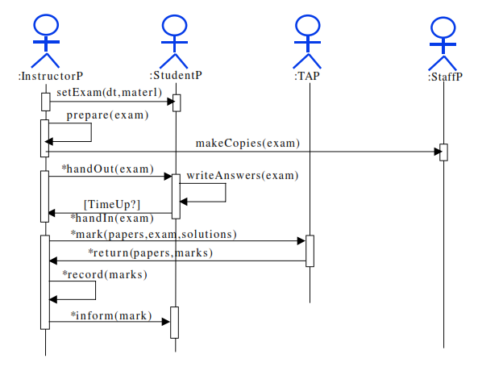
Practice

Slide 12
PREVIEW FOR LECTURE 11
OBJECT AND PATTERNS

